Slide 1



Cognitive Customer Engagement
CCE
Dec 2019 (v1.0)
Anju Chopra

Slide 2



Cognitive Customer Engagement
C C E
CCE is an extensible software platform that imparts cognitive capabilities and intelligent automation to customer interaction and client’s business processes using multiple communication channels by seamlessly integrating client’s front and back office systems and business workflow.

Slide 3
Cognitive Customer Engagement
Vendor Agnostic
(Amazon, KORE AI, Google, IBM Watson, Uipath, etc.,)
BOT Ecosystem
(Harmony of Voice, Chat, Email, Knowledge and Task Bot)
Omni Channel Touchpoint
( Online, Offline, Instant & Social Messaging )
Natural Language Understanding
( Intent , Entity and Tone Identification)
AI & machine Learning
(Pattern Recognition & Deep Learning)
Integration with Business Applications
(Enterprise Systems, Email & Workflow Solutions )
Business Analytics & Customer Insights
(Social Listening, Empathy Detection, Behavior Analysis)
24X7 Real Time and Almost - Real Time Experience
Secured & Compliance Deployment Model
(Orchestrate Cloud & On-Premise )

Slide 4
Core Features
Omnichannel Customer Interaction (Chat, Email, Social Media, Community)
Natural Language Understanding
Query Classification and Routing
Automated Machine Learning
Integration with Client Business Application and Workflows
Integration with Business Knowledgebase
Analytics Integration for Actionable Insights
Business Intelligence
Security and Compliance
4

Slide 5

Modules
Emailbot
Automates selected tasks by managing responses & responding to emails
Integrated and Non-integrated
Chatbot Conversational AI designed to simplify human interaction with
FAQ based approach
Voicebot
Beyond IVR, AI powered digital assistants engage with your customers
Agent Assist
Automates elements of what the call center agent does with his/her desktop tools and/or 2) says to customers during the customer interaction
Guided Workflow Bot, Knowledge Base Search
CCE
Trainerbot
Customer chat & voice simulation for training agent
Chat TrainerBot, Voice TrainerBot
Survey Bot
AI based conversational survey tool that helps you create engaging surveys

Slide 6


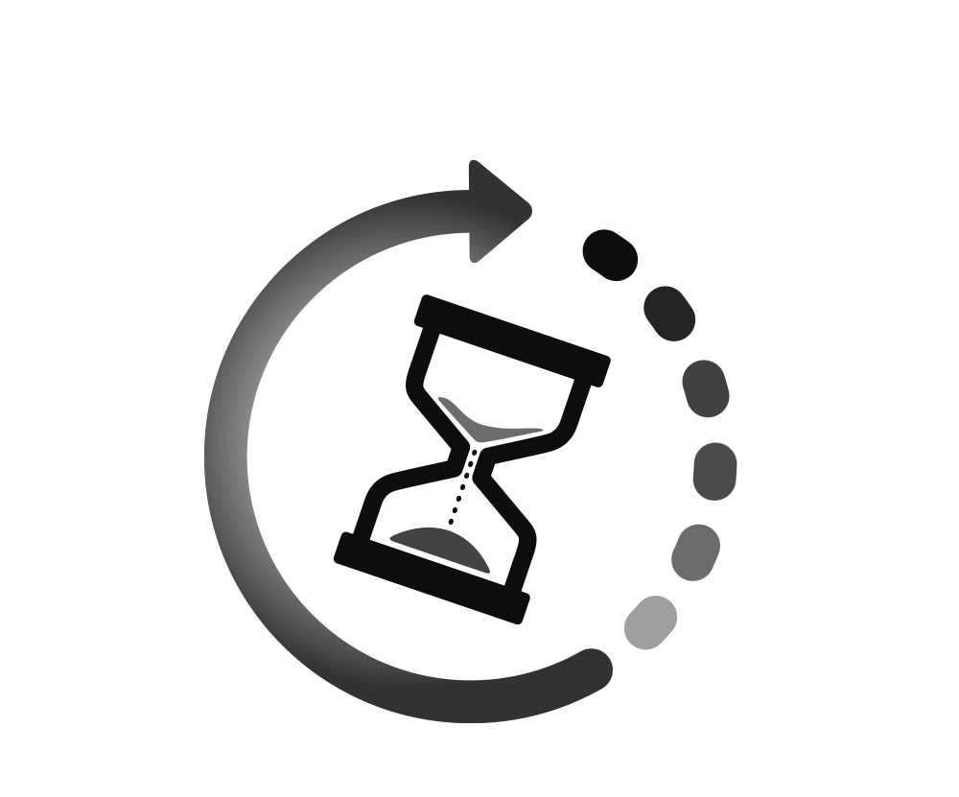



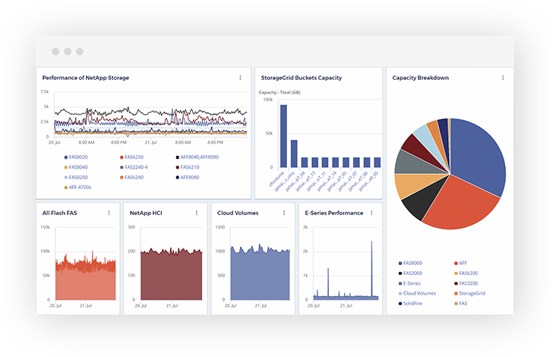

Business Benefits
Operational Cost Reduction
CSAT Improvement
Average Handling Time
Improvement
Efficiency Improvement
First Call Resolution Improvement
Accuracy Improvement
Monitoring Data & Gaining Insights
Increased Customer Engagement
6

Slide 7
Design Attributes
Scalable
Start small and scale up as user base grows
Add more features as pluggable services
Integrateable
Easily integrate with client systems using APIs and configurations
Portable
Port easily to different platforms (Cloud, On Premise, Windows, Linux, Azure, AWS)
Responsive UX
Modern responsive UI, extendible to mobile platforms
Multilingual UI
High Availability
High availability with up to 99.9% uptime
Extensible
UI Support for multiple languages

Slide 8













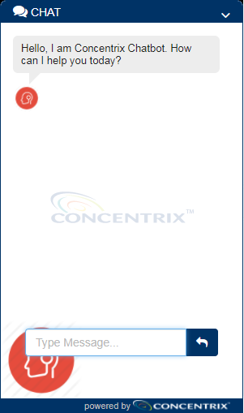
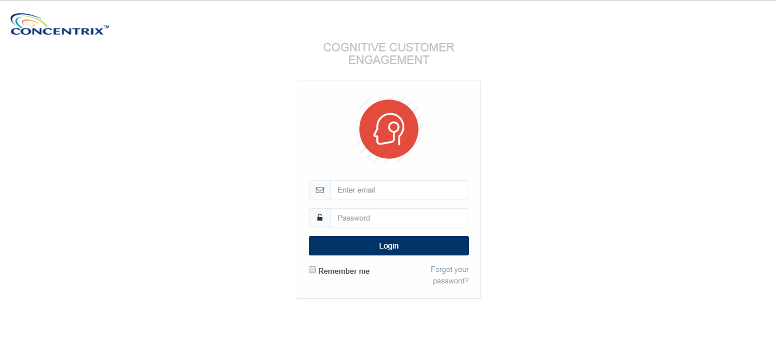




CCE Framework
Telephony
Platform
CCE Framework
Customer
Call back customer
Cognitive APIs
Orchestrator
Cloud / On Premise
PII Data Masked
Email Service
Speech to text/text to speech
SECURITY
CONTEXT
Chat Service
Intents/dialogs/entity
Speech API
TrainerBot Service
Email & responses
Conversation API
Reporting Service
Chat & responses
NLU API
FAQ/document search
KM Service
Discovery Service
Analytics
Integration Service
Data NOT Persisted
Speech Analytics Platform
QnA Service
Enterprise systems
Third Party
Transcripts
Conversation Service
Third party API
DWH
Scheduler
PII Data Encryption
Translation Service
Enterprise
API
CRM
Email
Chat
AI Service
ERP
Email/Chat/Social/Community channel Integration
Social
Community
Third Party
Platforms
Reporting Service
Agent & Supervisor Front End

Slide 9
CCE Modules
Voicebot
Voicebot
Emailbot
Chatbot
Chatbot
Chatbot
Trainerbot
Chatbot
Trainerbot
Survey Bot
Survey Bot
Agent Assist
Agent Assist

Slide 10








Available Features – EmailBot
Intelligent Automation
Intent identification using AI/ Machine Learning/NLP and generate response automatically based on intent and their categories.
Reporting
Automatically Generate Response
Ability to generate response with or without attachment automatically based on email category and intent. User can review the response, edit it if needed or send email as it is. S/he can change font and add multiple attachments as well.
Categorize Emails
Intent wise graphical report available
Add/update an email template
Categorize Emails based on business rule.
Account summary report available on dashboard.
Add/update users
Add/update intents.
Option to update email category manually and system display the response as per the updated category.
AI can be trained incrementally to handle new scenarios
Integration
Option to create Ticket / FTR & Non FTR cases in CRM
Agent can use the response generated by bot and paste in outlook/any email client/CRM system.
Sentiment Analysis
Admin Task
Email Assigning
Sentiment analysis helps you keep track of the moods of any number of customers for your team.
Ability to automatically assign emails based on Intent/business rules and user get an option to assign emails manually as well..
Chatbot
Emailbot
Voicebot
Trainerbot
Agent Assist
Survey Bot

Slide 11

Available Features – ChatBot
01
Live Chat, Team Chat, Messaging
LiveChat provide immediate customer support and information to clients and customers. Customer can chat with live agent to resolve their queries.
Enable Chatbot to answer your customer queries quickly and more faster, Accessible anytime, Personal Assistant, Cost Effective and many more.
02
Integration with Chatbot
03
Chat Transcripts / Interaction History
Access the entire history of Chat interactions
Chatbot
Chatbot
Voicebot
Emailbot
Trainerbot
Agent Assist
Message Translation / Multilingual
Survey Bot
04
Automatic real-time message translation between users. Supported 100 languages.
CCE
Chat Platform
Option to get immediate feedback if answers provided are satisfactory. Also, can ask customer to conduct a Survey.
05
Customer Feedback/ Survey
Web, Desktop & Mobile support
Accessible from any device with internet access including Windows, Mac, and mobile or tablet devices using the iOS and Android native mobile apps
06
07
Hassle free Integration
Hassle free Integration with any client tools/application (CRM, Sales Force, Client website, Facebook messenger, WhatsApp, SMS)

Slide 12
Available Features – VoiceBot
Conversational IVR Technology
Reduce agent calls
Improve call routing
Increase customer satisfaction.
Chatbot
Emailbot
Voicebot
Voicebot
Trainerbot
Agent Assist
Survey Bot

Slide 13
Available Features – Agent Assist
Guided Workflow Bot
Guided workflows facilitate the way business processes that include SAP steps can be implemented and align business users without requiring an extensive understanding of the underlying SAP process
Workflow automation enhances company productivity through structured systems.
Knowledge Base
Its easy integrable, and can be integrated with CCE, Sugar CRM or any other application.
Helps agents to work faster, better, save time and provided the right information at the right time within the business workflow.
Search seamlessly across a wide range of content and provide relevance-ranked results.
Upload multiple documents of different formats.
Searched result won't vary from agent to agent and response time will be greatly reduced.
Improves agent satisfaction as agents no longer have to hunt through hundreds of macros for the best answer to a question.
User friendly UI to configure workflow with advance branching option
Chatbot
Emailbot
Voicebot
Trainerbot
Agent Assist
Agent Assist
Survey Bot

Slide 14
Available Features – TrainerBot
Trainees can interact with the Bot in Voice and chat, its helps them to take the training Realtime.
It provides accurate, crisp and sympathetic responses and ensuring trainees to meet these qualities. Trainer BOT, with simulated chat/voice conversations, trains the agents to address different scenarios that they will face in the real world with the customers.
User-friendly Setup & Configuration.
Multiple Voice Accents for English – Indian, US , UK & Australian (Male & Female Voices)
Real-time Speech to Text conversion in Voice
Scoring after each Interaction
Additional KPIs like Rate of Speech, Dead Air, Opening / Closing Message in voice
NLP support in chat/voice trainerbot.
Chat & Voice
Practice
NLP
Usecase with Multiple Scenario
Reporting
Multiple Bot Voice Accents
Improve AHT
Interaction History
Chatbot
Emailbot
Voicebot
Trainerbot
Trainerbot
Survey Bot
Agent Assist

Slide 15
Available Features – Survey Bot
Automatically Tigger Survey
Ability to trigger survey automatically based on business rules.
Surveys can be sent to all employees or specific groups based on their location, department or seniority.
Survey Configuration
Analyze survey response, view question level analytics and take measures to improve.
Embed
Embed survey bot in your website or app easily
Survey bot allows Workplace admins to get employee input on a range of subjects with specify scales via pre-defined button based response
Analyze
Chatbot
Emailbot
Voicebot
Survey Bot
Trainerbot
Survey Bot
Agent Assist

Slide 16















CCE Emailbot Workflow
Client
Enterprise System
Email Extraction
CRM, ERP, Business Workflow Data
Client Enterprise API Calls
CCE Framework
Email Download
Scheduler
Entity Extraction from Email
Data Security
(Masking PI/SPI Data)
Email Classification, Routing and Business Logic
Create and Send Email Response
and User Review
QC Workflow and Bot Training
Cognitive APIs
Intent and Tone Analysis of Email Subject and Body
(No Data Persist here)

Slide 17







CCE Chatbot Workflow
User Converses with Chatbot to request information
No
User Satisfied with response received from Chatbot
Yes
Customer
User Close Chat
CCE Platform
Chatbot Respond Real-time, perform actions and ask for more inputs
Yes
Request Analyzed by CCE Chatbot intelligence
Chatbot Understand Request
Chatbot Respond Real-time and Transfer chat to logged Agent
Chat received by Agent and Agent respond to User
No
Cognitive APIs
Intent and Entity Extraction from Chat Message
Tone Analysis of Messages and Display Chat History

Slide 18
Cognitive Customer Security
Data Security & Encryption
CCE Security via Authentication
Use of token based authentication without disclosing personal information identifier. The credentials are transmitted via HTTPS for authentication.
Base Security
Security policy requires the following:
The sensitive data is masked for display purposes, Only metadata is processed using cognitive APIs
No sensitive data is persisted on IBM Watson cloud. PII data is encrypted(AES) while being persisted in CCE Application
CCE segregates the Metadata and sensitive data via entity extraction.
A temporary token is generated which stays valid for 30 minutes. Role based security and access control is enforced using token based
All services include network and storage encryption. Circuit and application level firewalls, security information and event management,
Intrusion detection, application source code scanning, penetration testing, and regular vulnerability scanning. Cloud application security is taken care by our cloud infrastructure and API providers i.e. AWS/Azure/IBM, where strict monitoring and auditing of Applications are performed on regular intervals . For details, kindly refer the following: https://aws.amazon.com/security/ , https://www.ibm.com/watson/watson-security.html
Physical and Logical Security
Physical security of CNX is defined at the global level and includes a layered approach that includes site, building, data center, and data center partitions.
Logical security consists primarily of technical means as specified by the CNX security team. CCE logical security uses the following safeguards:
Isolation of customer data and Procedures for an emergency shutdown to prevent data leakage. Security for user devices and Application of security patches.
Network configuration that includes zoned security layering that is enforced by mandatory firewall and router rule sets. Antivirus and anti-malware protection with automated workstation compliance tools. Vulnerability scanning and intrusion detection. Change management process and information systems maintenance. DDoS protection of inbound circuits to data centers. Ongoing internal & external penetration testing/ethical hacking program. Ongoing internal & external penetration testing/ethical hacking program.
Regular application source code reviews, threat modeling, and application scanning.

Slide 19



Leading American life insurance Company
Case Study: Cognitive Automation of Customer Chat Support Process
Business Challenges
Concentrix Solution
Results
High volume calls and concerns over increase in AHT, Customers hassled with registration and security process before getting to their request.
Emphasis on reducing AHT to meet client’s expectations caused error rates to rise.
Client wanted to route more volumes by expanding the contact center, however, did not want to incur higher costs in order to do so.
Concentrix designed and implemented a Chatbot to automate response using Cognitive Automation platform and automated all supporting activities like: Registration process, Billing & payment, Update policy & personal details and New policy loan.
The Cognitive AI solution enabled customer(s) to interact with a specialist (liveChat agent) to help them on real time bases and provide resolution post Bot interaction.
Depletion in calls, As most of the FCR are met either by ChatBot or LiveChat.
Reduction in Error rate well below target and, in fact, virtually eliminated.
Around 20-25% call volumes routed to chat bot & Livechat Agent with reduction of staff or cost.
Concentrix Cognitive Automation Implementation

Slide 20
Concentrix Human resources team
Case Study: Cognitive Automation: HR Knowledge Bot
Business Challenges
Concentrix Solution
Results
Accessibility/Visibility to raise a concern/issue/getting information was a long process for the employees.
Lack of unified platform to raise and receive employee quires.
“Be made to wait” to respond to the incoming Queries.
Large number of manual checkpoints and validations, multiple apps / screens etc leading to errors and escalations which is also resulting in increased rework
Concentrix deployed an integrated automation based on business data to respond quickly to employee’s grievance
The Cognitive AI solution integrated chatbot within Concentrix’s Enterprise Mobile App and its accessible to respond to employee queries anytime.
The Cognitive Automation chatbot is configurable to multiple queries related to different departments
Turnaround time to respond to a query reduced from 1-2 days to less than a Minute.
Reduced Manuel intervention.
Deploy across the organization
Lessen HR & Operational Workload
Concentrix Cognitive Automation Implementation

Slide 21
Concentrix Payroll Team
Case Study: Cognitive Automation: Payroll Knowledge Bot
Business Challenges
Concentrix Solution
Results
Unanswered queries of employees about their payroll leading to dissatisfaction
Lack of Bandwidth to support on numerous payment and investment issues during a month end or financial year ending.
Agents providing customer support on email had to access multiple systems and follow a complex case research involving process deviations and missed steps
We automated employee information retrieving process and structuring the Chatbot to automate response using Cognitive Automation platform
Concentrix deployed an Cognitive AI solution to save agents time from redundant activities across multiple legacy screens like Ramco, Ebucks and etc.
Reduced cost per contact, A small change in Employees Payroll policies can keep the finance team really busy.
Simplified process with the flexibility of customizing generated replies for more focused outputs
Reduction of nearly 50% of the Queries. Which is responded or addressed by chatbot
Concentrix Cognitive Automation Implementation

Slide 22
Concentrix Transport Team
Case Study: Cognitive Automation: Transport Knowledge Bot
Business Challenges
Concentrix Solution
Results
Immense pressure from accounts/ODC to have Admin’s presence to address employee’s grievances
Bundle’s of email queries, emphasis on meeting the employee’s expectations and leading to escalations.
Manual and redundant nature of processes was contributing to higher than desired timeline and Tats
Deployed Cognitive AI solution to ensure BOT serves the employee(s) grievances flawlessly.
Concentrix designed chatbot using Cognitive automation platform to optimize and re-engineer the overall process to eliminate inefficiencies and redundancies
We automated employee information retrieving and are generating replies for Intents recognized through an AI engine
Drastic reduction in Email Queries.
Faster and Structured Workflow with minimal manual intervention leading to reliable and smooth employee journey
Efficiency gain of approximately 30% which can also manage volume spikes without a need for additional human intervention
Concentrix Cognitive Automation Implementation

Slide 23
Concentrix Global Service Desk
Case Study: Cognitive Automation of Helpdesk Tickets
Business Challenges
Concentrix Solution
Results
High volume tickets and concerns over handling time: GSD team was piled up with too many helpdesk tickets all the time that caused users getting delayed solution to their requests.
Increased error rate due to accelerated manual processing to clear email ticket backlog.
Concentrix designed a mail bot that pulls all the email sent to helpdesk@concentrix.com, AI system creates the reply and send the draft to Omni where GSD user would review the mail and forward the same to end user for the scenarios like password reset, account unlock, DL creation, VPN, shared drive access, Coupa, system issue and general queries.
The cognitive AI solution provides GSD team preprocessed email where they need to review the matter and click on send button.
Reduction in AHT: As GSD team did not have to write the email and draft was readymade, it resulted in AHT reduction.
Reduction in Error rate: Since the system is now automated for email content, it eliminated the typo and content mistakes.
25-30% relevant volume was processed automatically basis the training data provided with high accuracy.
Concentrix Cognitive Automation Implementation

Slide 24
An Indian online travel company
Case Study: Cognitive Automation – KBOT
Business Challenges
Concentrix Solution
Results
Complex process with frequent process updates, required agents to approach SME’s frequently for clarifications on live calls by putting customer on hold effecting AHT and Customer experience.
Increased error rate due to Lack of knowledge base.
Concentrix designed and deployed Knowledge BOT (Automated Chat Engine) to provide ready help to agent queries, thereby reducing agent hold/TT and dependency on SME, resulting in improved customer experience
Reduced AHT, Improved quality and Customer experience
Empowered agents
Reduced Manuel intervention as Little or no dependency on SME.
Deploy across two locations Ranchi & Kolkata.
Concentrix Cognitive Automation Implementation

Slide 25
US Biggest eCommerce Client
Case Study: Training Chat Bot Deployment
Business Challenges
Concentrix Solution
Benefits/Savings
New Hire performance on AHT was below Client target
Process/Product training was highly dependent on the Trainers
Seasonal ramp needed hiring of additional trainers or upskill temp trainers
No self paced mode to conduct multiple training batches or refresher sessions
Deployed Chat based Trainer Bot which lets the New Hire agents to practice multiple modules on their own and it also measure agents performance
10 product modules from top call drivers were configured for 3 training batches with about 30 trainees as a Pilot
Batches were made to practice the Call/Chat scenarios for the 10 modules multiple time on their own till they achieved 100% resolution
1.70 Min (15%) of AHT reduction for 3 Pilot batches with 9K USD Saving for the Client
~14 FTE benefit with 36K USD Saving for CNX Annually
STATUS:
Training Bot to be rolled out to all Lobs in 2020 as per Client priorities
Concentrix AI Implementation

Slide 26
Module Wise Demo’s
Emailbot
Integrated Emailbot: https://cnxmail-my.sharepoint.com/personal/nitesh_gupta_concentrix_com/Documents/TempShare/Emailbot/Emailbot%20-%20Demo%20recording.wmv
Chatbot
FAQ Based Chatbot: https://cnxmail-my.sharepoint.com/:v:/g/personal/nitesh_gupta_concentrix_com/ET85tLuhbAlFiqlVkejd7REBq1xv6DArc8r-6yXssCCMvw
VoiceBot
Voicebot: https://cnxmail-my.sharepoint.com/personal/nitesh_gupta_concentrix_com/Documents/TempShare/VoiceBot/VoiceBot_LEX_Flight_Demo.mp3
Agent Assist
Chat Trainerbot: https://cnxmail-my.sharepoint.com/personal/nitesh_gupta_concentrix_com/Documents/TempShare/Chat%20TrainerBot/Chat%20Trainerbot%20-%20Non%20Voice%20(multi%20assessment).wmv
KnowledgeBase: https://cnxmail-my.sharepoint.com/:v:/g/personal/nitesh_gupta_concentrix_com/ESWfUJCJ1hZPo2UjA20EOkABJ0ZabZ3q31IOCS0CcWFHrg
TrainerBot
Non-Integrated Emailbot: https://cnxmail-my.sharepoint.com/personal/nitesh_gupta_concentrix_com/_layouts/15/Lightbox.aspx?url=https%3A%2F%2Fcnxmail-my.sharepoint.com%2Fpersonal%2Fnitesh_gupta_concentrix_com%2FDocuments%2FTempShare%2FEmailbot%2FEmailbot%20-%20Generate%20Response%20feature.wmv
Voice Trainerbot: https://cnxmail-my.sharepoint.com/:v:/g/personal/nitesh_gupta_concentrix_com/EV7dJ9N15_NPkplG3_s1yJUBPZM3Qov4b8zoOFnt2rvrWQ

Slide 27
Thank you……

